Slide 1


Course Code: ETCCCH104
Course Name: Engineering Chemistry
Program: B.Tech
Dr Deepak Yadav
Assistant Professor, Department of Chemistry
School of Basic and Applied Sciences
K.R. Mangalam University
Sohna Road, Gurugram

Slide 2
Neoprene, Isoprene, Nylon-6, Nylon-6,6 , Decron and Terylene

Slide 3
Session Outcomes
Understand the preparation and properties of selected synthetic polymers.
Differentiate between various types of nylons and polyesters.
Identify key applications in textiles, engineering, and daily life.
Compare structural features and advantages.

Slide 4
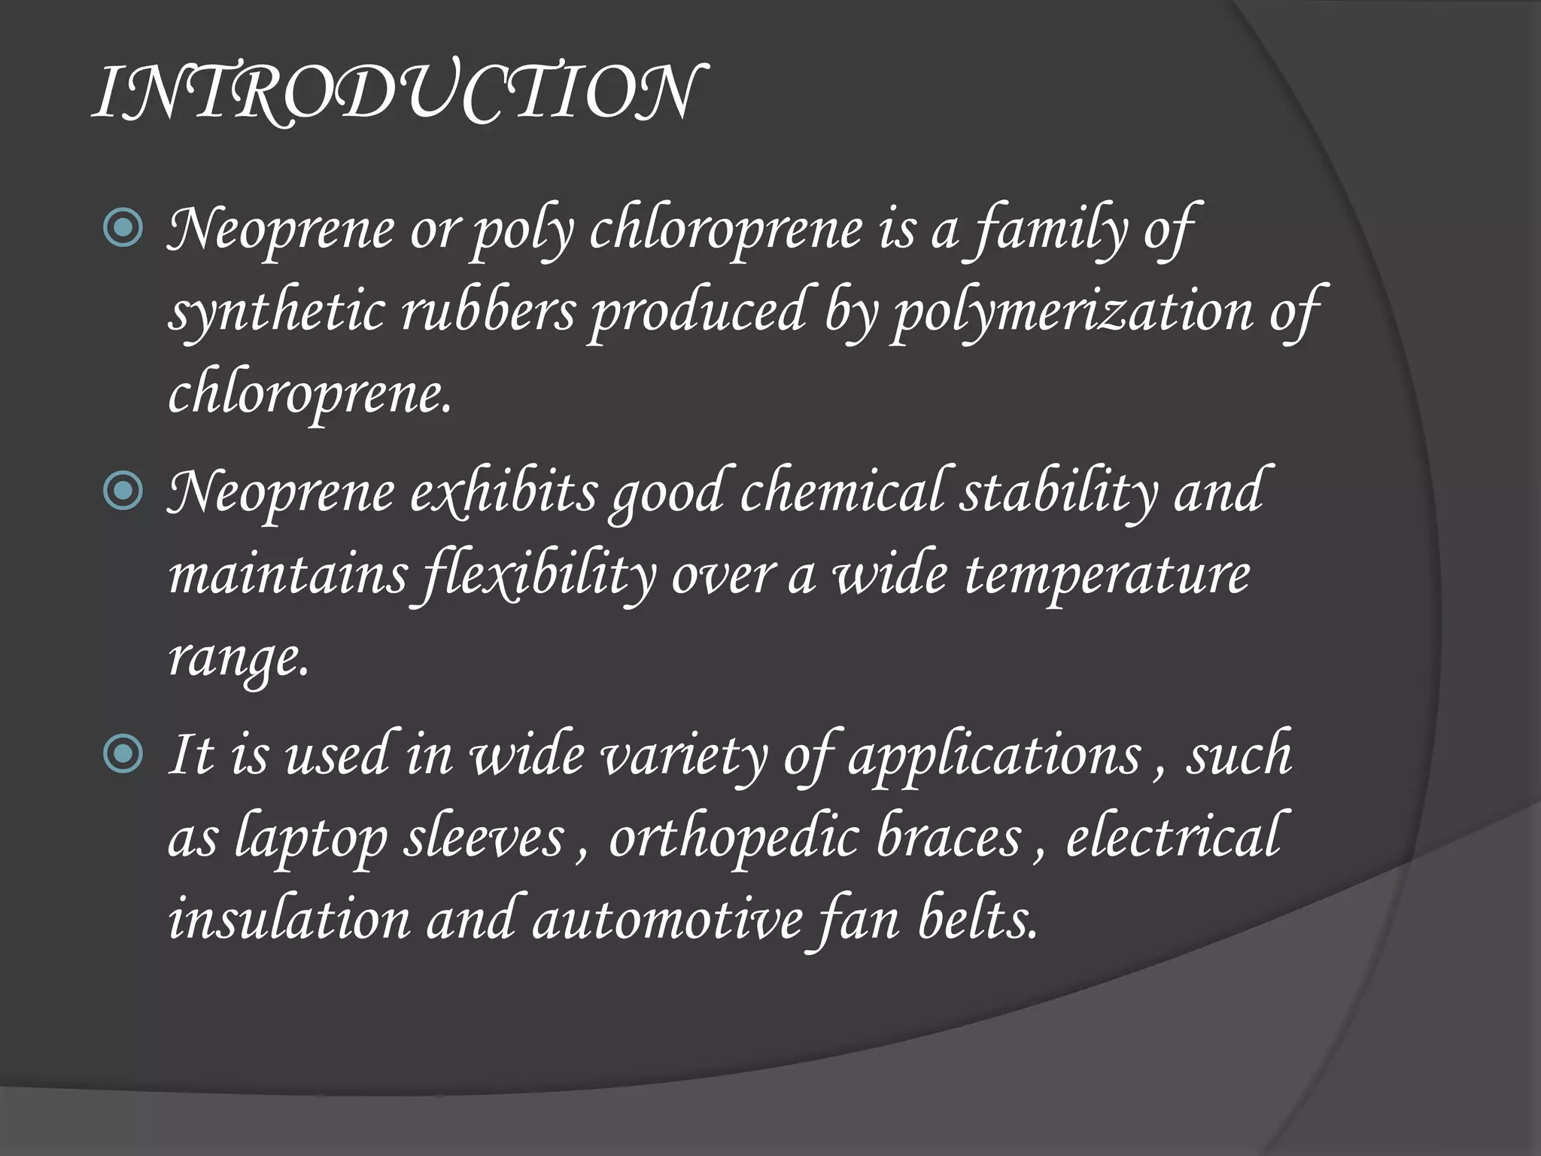
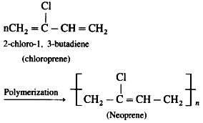
Neoprene

Slide 5
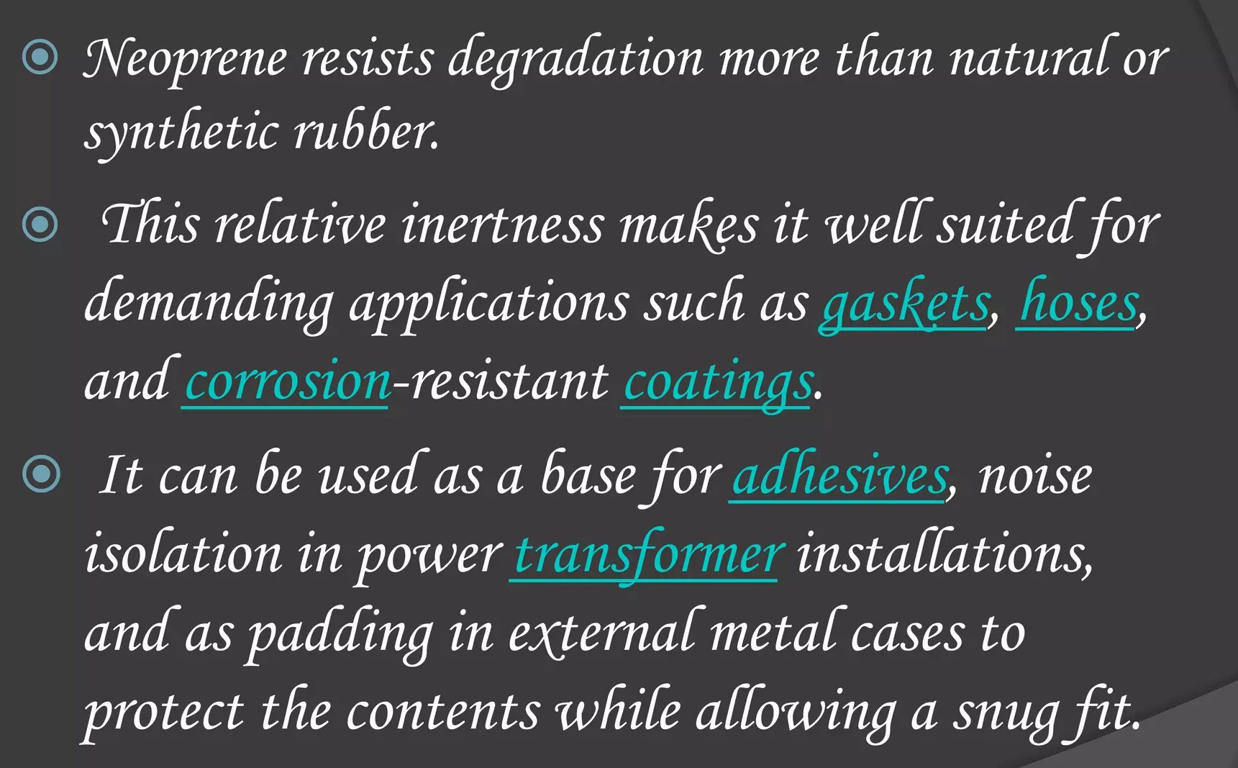
Applications:

Slide 6
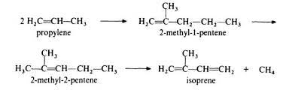
Isoprene
Isoprene, a colourless, volatile liquid hydrocarbon obtained in processing petroleum or coal tar and used as a chemical raw material. The formula is C5H8.
It is used mainly in the production of isoprene rubber (used in vehicle tyres), block polymers containing styrene (used as thermoplastic rubbers) and pressure-sensitive adhesives and in butyl rubber used for construction of hoses and tyres.

Slide 7
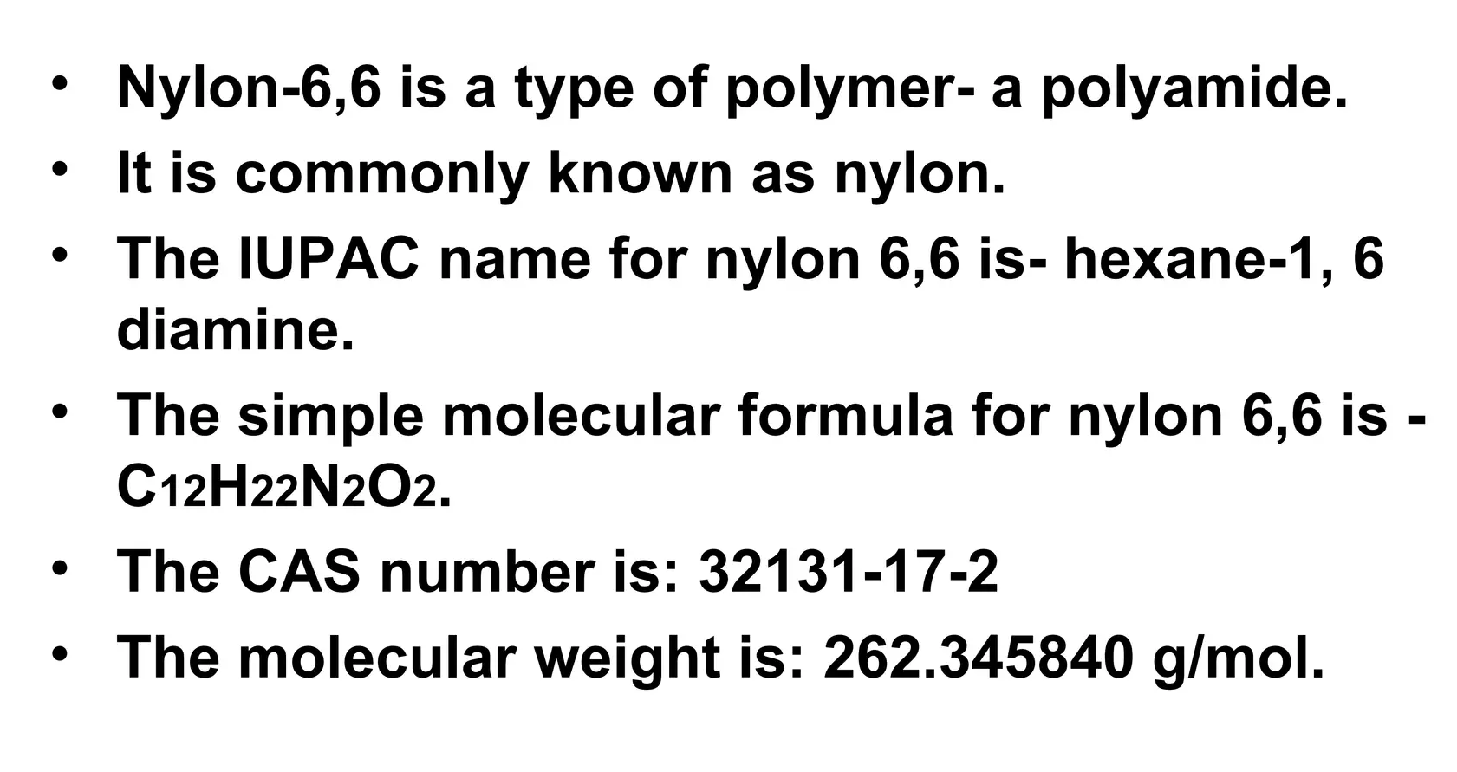
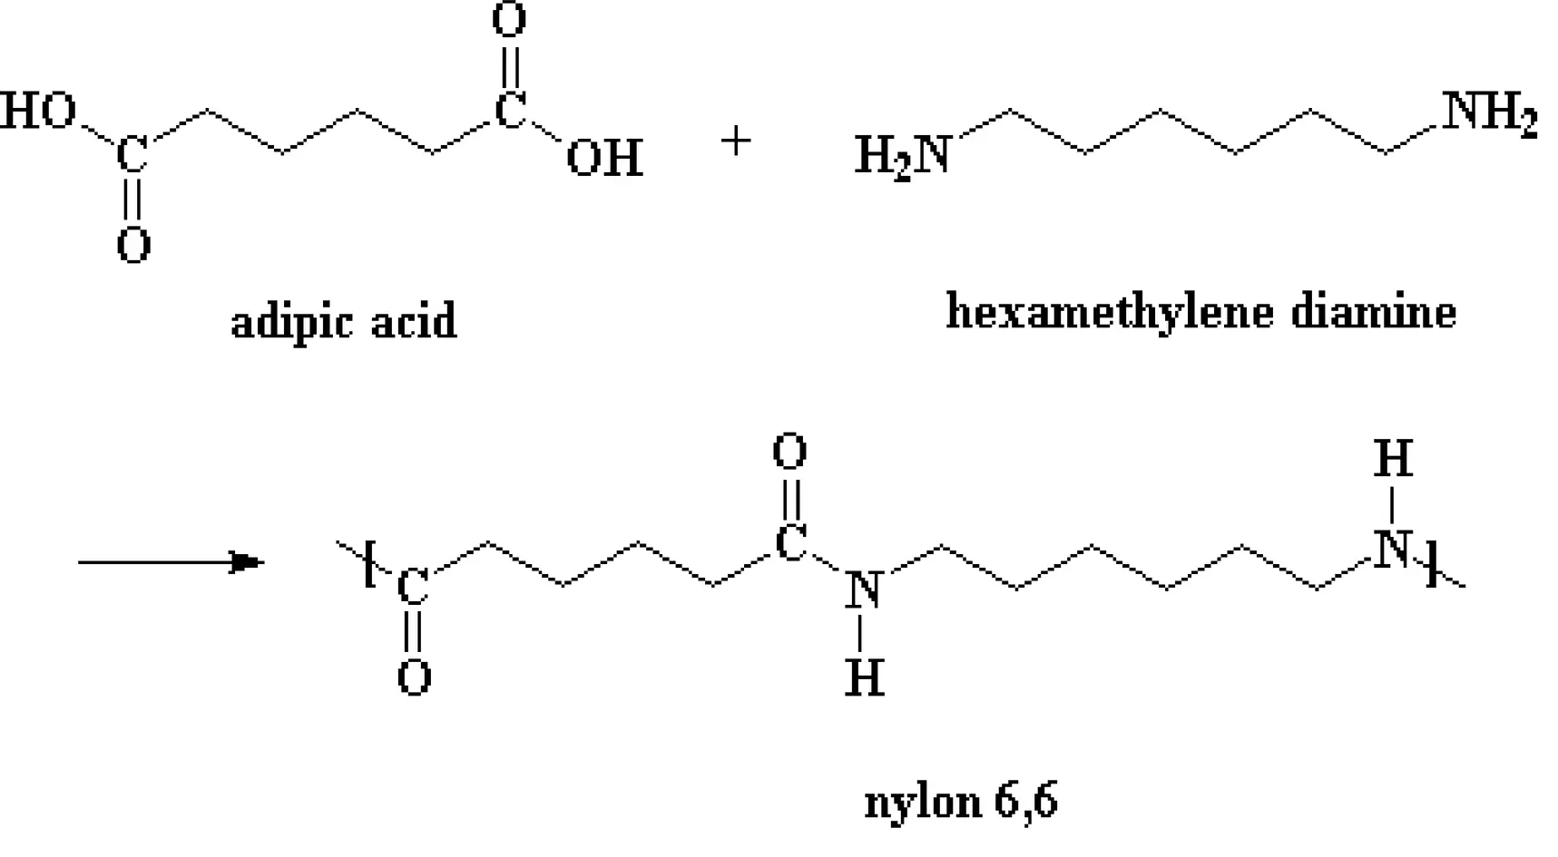
Nylon-6,6

Slide 8
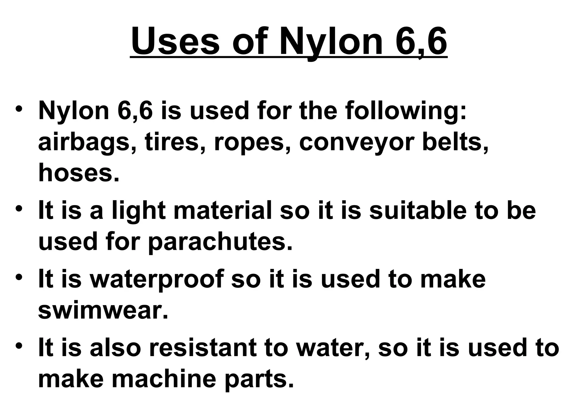
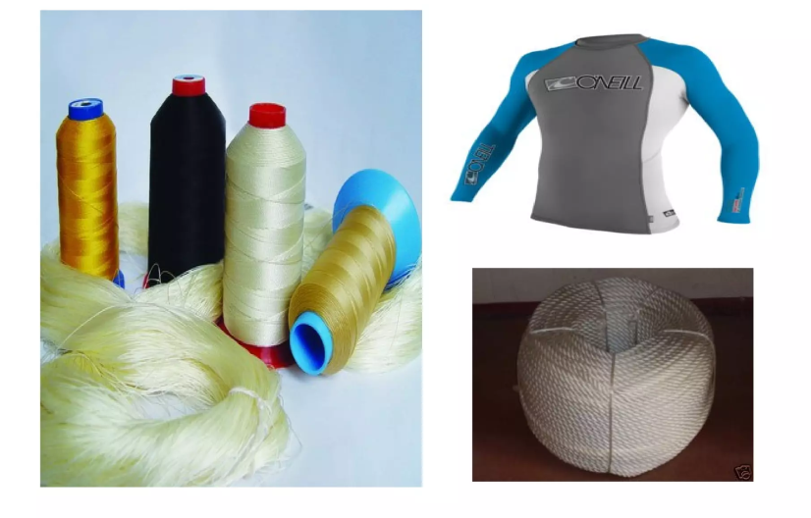

Slide 9
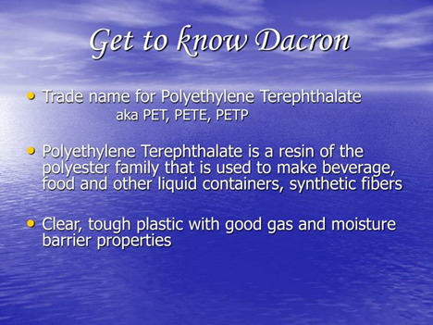
Dacron / Terylene

Slide 10
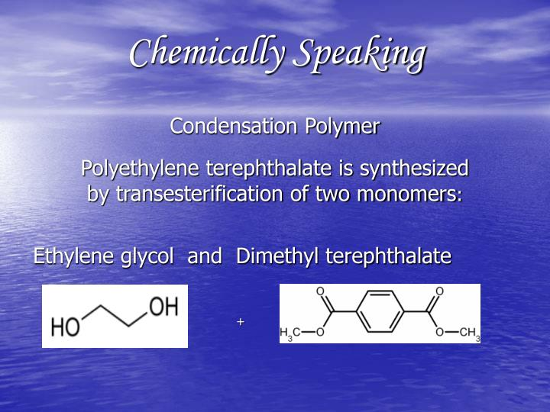
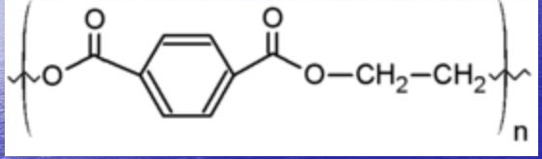

Slide 11
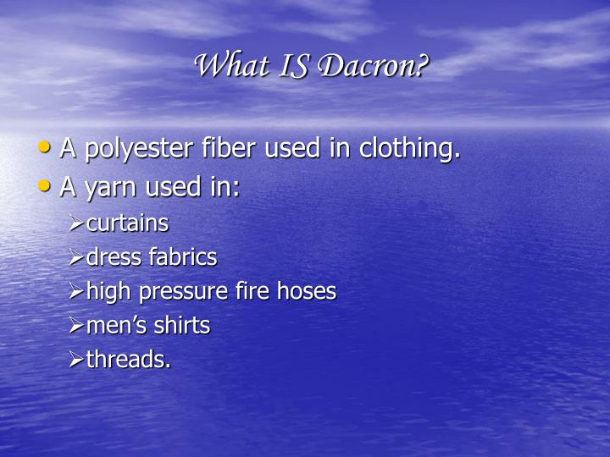
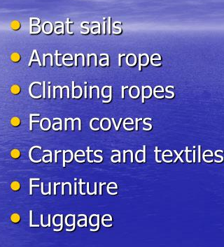
Applications:

Slide 12
Comparison Table
Polymer | Monomer(s) | Type | Key Properties | Applications
Neoprene | Chloroprene | Addition (radical) | Oil, solvent resistant | Wetsuits, gaskets
Isoprene Rubber | Isoprene | Addition | Elastic, natural rubber substitute | Tyres, footwear
Nylon-6 | Caprolactam | Condensation | Strong, flexible | Fabrics, nets
Nylon-6,6 | Hexamethylene diamine + Adipic acid | Condensation | Heat resistant, tough | Carpets, ropes
Dacron/Terylene | Ethylene glycol + Terephthalic acid | Condensation | Strong, wrinkle resistant | Textiles, bottles

Slide 13
Takeaway of Session
Synthetic polymers are designed to overcome limitations of natural ones.
Neoprene: resistant to oil & solvents.
Isoprene Rubber: synthetic substitute for natural rubber.
Nylon-6 & Nylon-6,6: strong fibers, engineering plastics.
Dacron/Terylene: polyester, widely used in textiles & packaging.

Slide 14
MCQs for Practice
Q1. Monomer of Nylon-6 is: a) Caprolactam b) Adipic acid c) Terephthalic acid d) Styrene
Q2. Nylon-6,6 is formed by condensation of: a) Caprolactam b) Hexamethylene diamine & Adipic acid c) Terephthalic acid & Ethylene glycol d) Butadiene & Styrene
Q3. Dacron/Terylene belongs to: a) Polyester b) Polyamide c) Polyisoprene d) Polyethylene
Q4. Neoprene is obtained from: a) Isoprene b) Chloroprene c) Caprolactam d) Adipic acid

Slide 15
Thank You

